Slide 1

ADAPTIVE AGENTIC SECURITY OPERATIONS CENTRE (SOC) FRAMEWORK
DEPARTMENT OF COMPUTER SCIENCE
JAWAHARLAL NEHRU TECHNOLOGICAL UNIVERSITY HYDERABAD UNIVERSITY COLLEGE OF ENGINEERING SCIENCE AND TECHNOLOGY
Kukatpally, Hyderabad
DISSERTATION WORK REVIEW – 1
AUGUST-2026
GUIDE:
Dr. I. Lakshmi Manikyamba
Professor, Department of CSE
JNTUH UCESTH
PRESENTED BY:
Aishwarya
22011P0532
CSE-IDP

Slide 2
Abstract
This project proposes an adaptive, agentic SOC framework for context-aware security operations. Specialized agents handle investigation, threat intelligence, attack-path analysis, response, and verification, with reasoning grounded in RAG and an Enterprise Knowledge Graph rather than model assumptions alone. An adaptive routing mechanism adjusts investigation depth by risk, and a closed verification loop confirms outcomes after each response.
2

Slide 3
Introduction
Modern SOC teams receive huge numbers of security alerts, causing alert fatigue and increasing analyst workload.
Traditional SOC systems depend mainly on rule-based workflows and manual analysis.
LLMs can assist in security analysis, but they may lack enterprise-specific context and can produce unreliable results.
Our project uses Agentic AI, RAG, Knowledge Graphs, and adaptive routing to make security investigation more contextual and adaptive.
3

Slide 4
Problem Statement
The problem is to reduce manual effort in threat investigation and response by adapting investigation based on alert risk and available evidence, while verifying the effectiveness of the response.
4

Slide 5
Objectives
Build an adaptive multi-agent SOC framework for context-aware investigation.
Deploy specialized agents for investigation, intel, attack-path, response and verification.
Integrate RAG over MITRE ATT&CK, threat intel, vulnerabilities and past incidents.
Build an Enterprise Knowledge Graph to validate attack paths.
Evaluate detection quality, latency, attack-path accuracy and human intervention.
5

Slide 6
Literature Review
Approach | Strength | Limitation
Traditional SOC / SIEM | Strong alert collection & rule-based correlation | High alert volume, heavy analyst workload
SOAR | Automates predefined playbooks | Fixed workflows, limited adaptability
LLM-based SOC assistants | Better summarization & reasoning | Can hallucinate; lacks enterprise grounding
AgentSOC (base paper) | LLM hypotheses + graph validation + risk scoring loop | Limited adaptive routing & post-response verification
6

Slide 7
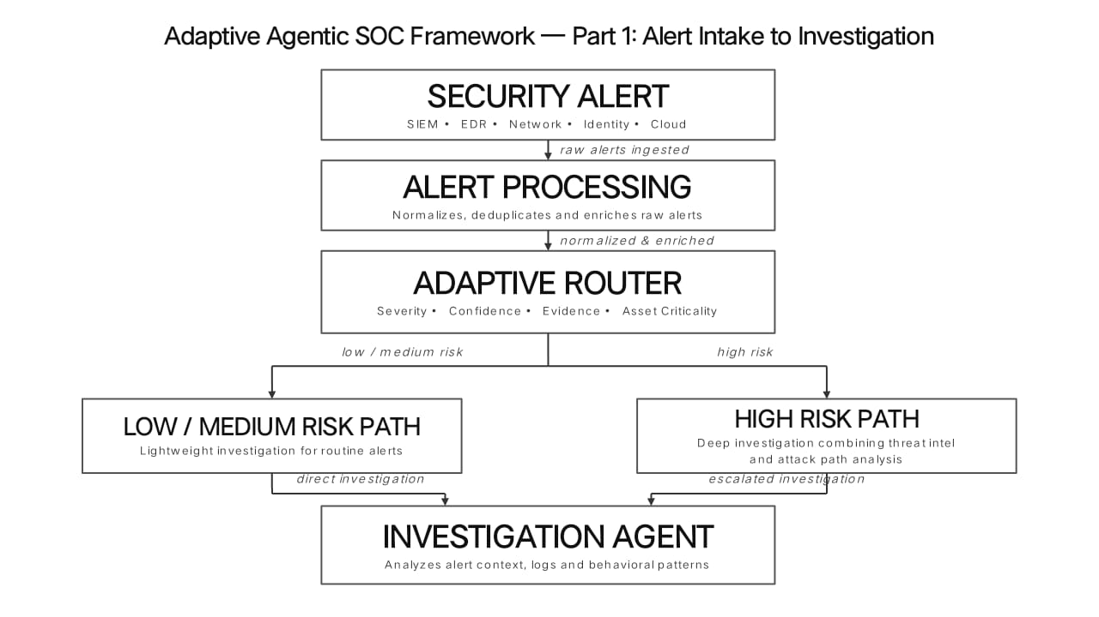
Proposed Architecture
7

Slide 8
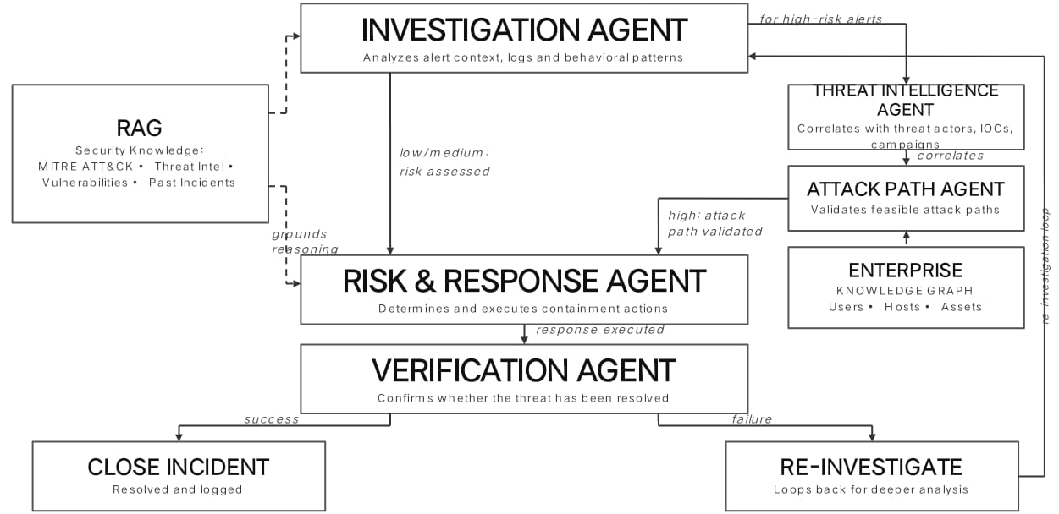
Proposed Architecture
8
8

Slide 9
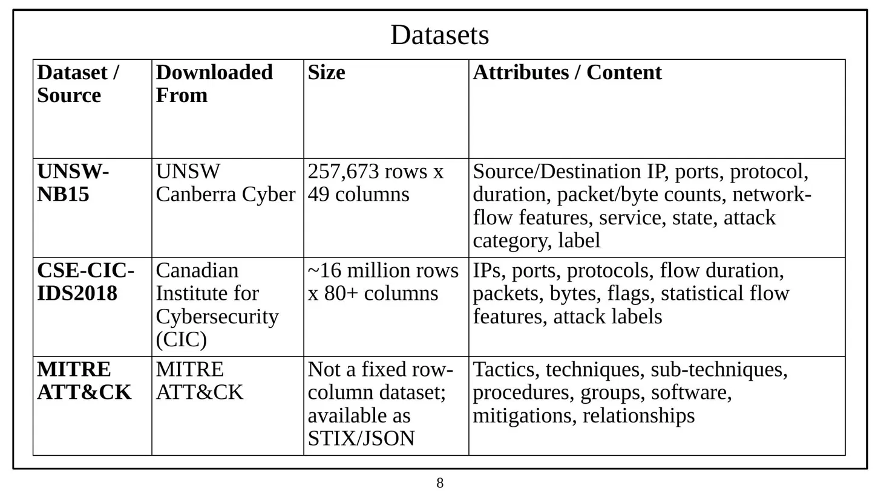
Datasets
9

Slide 10
Technology Stack
Backend (Python, FastAPI): API layer handling requests, routing them to the agent orchestration engine
Agent Orchestration (LangGraph, LangChain): Manages the workflow; routes tasks to specialized agents
LLM (GPT-4 API): Core reasoning — summarizes alerts, generates hypotheses, drafts responses
RAG (Vector DB): Grounds LLM reasoning in real threat intel/docs, reducing hallucination
Graph (Neo4j): Enterprise Knowledge Graph validates attack paths across hosts, users, assets
Database (PostgreSQL): Stores assembled context, agent outputs, and case history
10
10

Slide 11
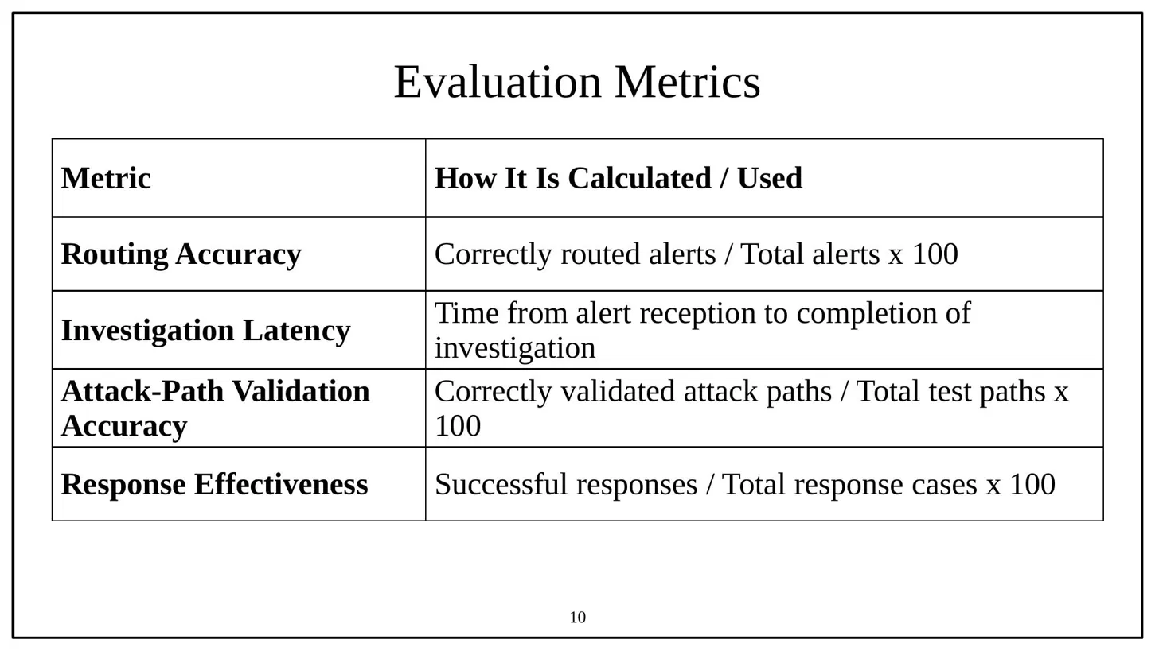
11
11

Slide 12
Conclusion
The proposed Adaptive Agentic SOC Framework improves automated security investigation by combining specialized agents, adaptive routing, RAG, an Enterprise Knowledge Graph, and closed-loop verification. The router adjusts investigation depth by severity, confidence, evidence, and asset criticality, while RAG and the Knowledge Graph ground reasoning and validate attack paths. The Verification Agent checks outcomes and triggers re-investigation when needed. Overall, the framework aims to make SOC automation more contextual, explainable, and adaptive.
12

Slide 13
References
1.Roy, J., & Singh, S. K., “AgentSOC: A Multi-Layer Agentic AI Framework for Security Operations Automation,” 2026 IEEE 5th International Conference on AI in Cybersecurity (ICAIC), 2026. [Base Paper]
2.Saju, M. H., & Azim, A., “Toward Autonomous SOC Operations: End-to-End LLM Framework for Threat Detection, Query Generation, and Resolution in Security Operations,” Proceedings of Machine Learning Research, Vol. 318, pp. 422–433, 2026.
3.Sharafaldin, I., Lashkari, A. H., & Ghorbani, A. A., “Toward Generating a New Intrusion Detection Dataset and Intrusion Traffic Characterization,” International Conference on Information Systems Security and Privacy (ICISSP), 2018.
4.Moustafa, N., & Slay, J., “UNSW-NB15: A Comprehensive Data Set for Network Intrusion Detection Systems,” Military Communications and Information Systems Conference (MilCIS), 2015.

Slide 14
THANK YOU

